Slide 1
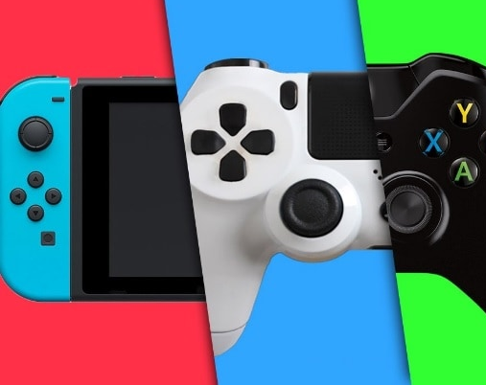
Project Exhibition-2 Review-1
TOPIC: USING HAND GESTURE IN GAMES
GROUP NO: 9
GUIDE: Dr. A. BALAJI

Slide 2
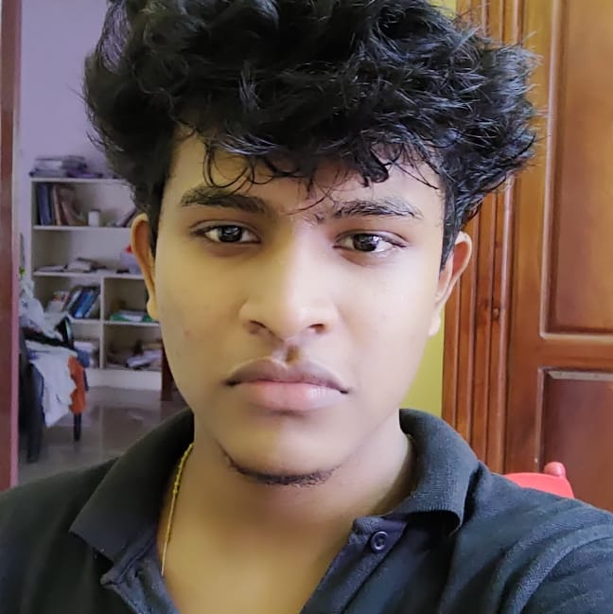


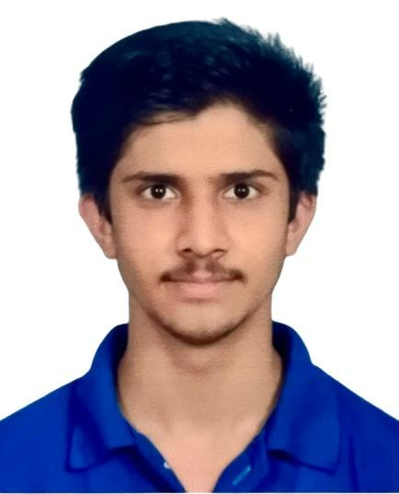


TEAM MEMBER DETAILS
21BCG10140 ALAN SAJI
21BCG10072 RISHIKESH M
21BCG10075 ANKIT SANKAR
21BCG10100 CHETAN KHOCHE
21BCG10080 SUMESH KUMAR J N
21BCG10109 NAVEEN GOKULAKRISHNAN

Slide 3


SOFTWARES USED

Slide 4

AI model to detect Keypoint (pretrained)
The Games
AI model to detect actions (retrained using custom dataset)
COMPONENTS

Slide 5

Create Games
Create dataset and prepare for training
Training and deploying the AI model
Integrating AI with game
TASKS

Slide 6
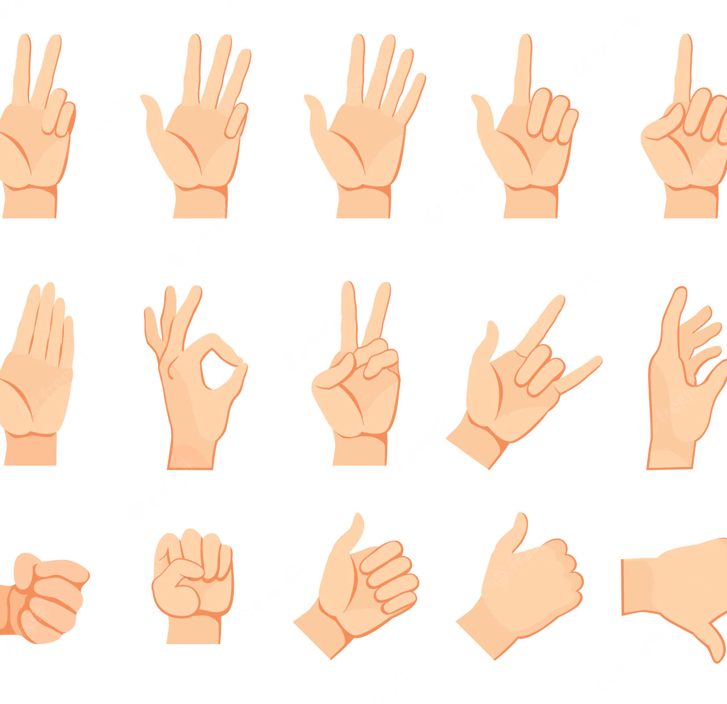
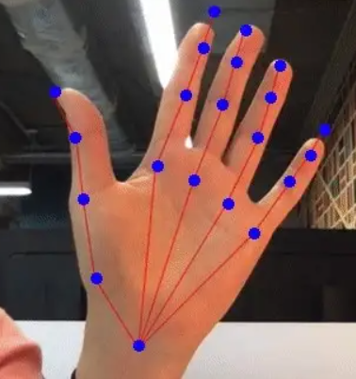
Building a hand gesture recognizer
To determine hand gestures from a camera picture.
If a hand is detected, we estimate the position of all finger joints to trace the hand skeleton.
Using the key points(21 key points also called “landmarks” make up our hands), we describe the curl and pointing direction for each detected finger.
Finally, we compare this description to a list of known hand gestures and check which one is the best match.

Slide 7
How it Works
Game will load and show a “please wait” message during initialization
Player and opponent are shown next to each other
The first round of the game is started by the press of a key or button
A new round starts with a countdown, asking the player to get ready
Player should show a hand gesture
Once a valid gesture is registered, it is compared to the computer gesture
The result is evaluated according to the rules of the game
Winner is awarded one point, score display gets updated
Start next round

Slide 8


